Slide 1
Digital Mobility Platforms and Ecosystems State of the Art Report

Slide 2
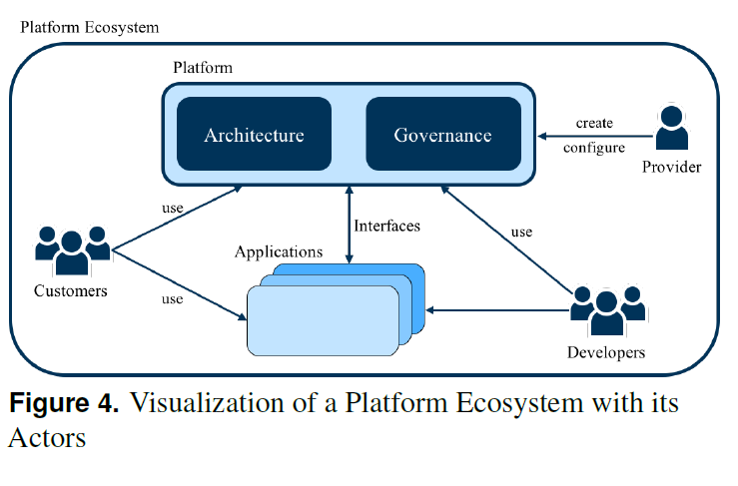

Slide 3
